Slide 1
Practical Algorithm Analysis for Oracle Developers
281
Jon Heller
Database Administrator
Ventech Solutions
jon@jonheller.org
2019-04-10

Slide 2
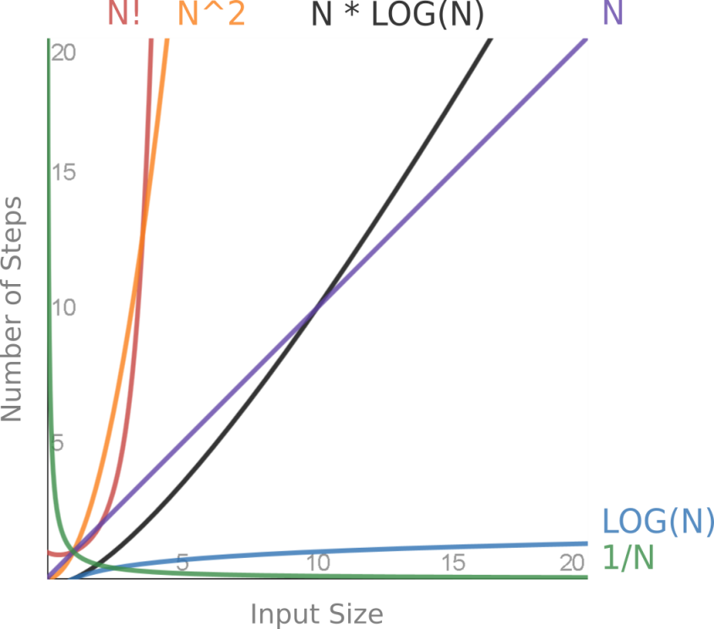
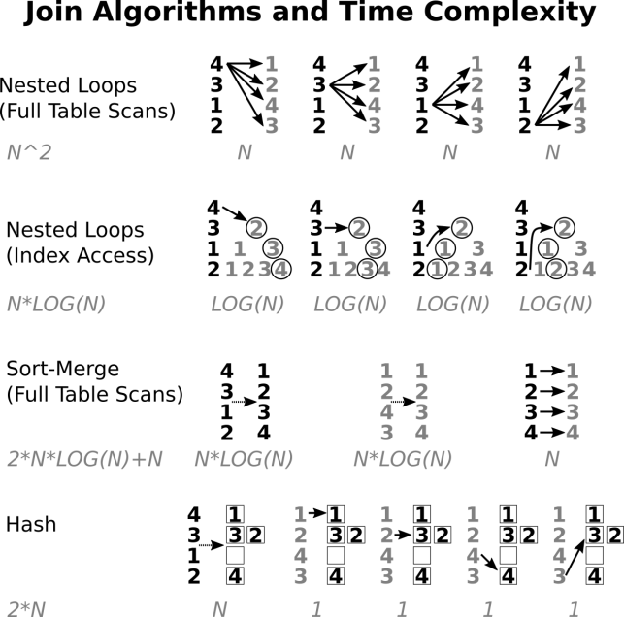
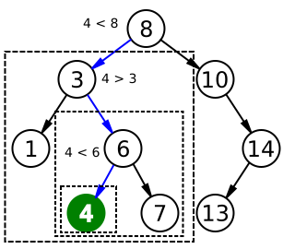
Practical Algorithm Analysis for Oracle Developers
Notes:
These images will all be discussed later.
(Binary search algorithm image created by Chris Martin and is in the public domain.)

Slide 3
Disclaimers
This is not a computer science lecture
No proofs or complicated math
Imprecise terminology: computational complexity, algorithm analysis, time complexity, asymptotic complexity, run-time analysis
Notes:
Although I have a BS and MCS in computer science I'm not an expert in algorithm analysis, and this is not a computer science lecture.
This presentation focuses on practical information, even though this is usually taught as a theoretical subject.
I'm sure I'm mixing up terms, but it shouldn't matter. And there's some overlap between Oracle terminology and computer science terminology. For example, and "operation" in Oracle means an algorithm used in an execution plan. Whereas an "operation" in algorithm analysis means a single unit of work, like adding or comparing numbers.

Slide 4
Presentation is Based on Chapter 16
Notes:
https://www.amazon.com/Pro-Oracle-SQL-Development-Practices/dp/1484245164/
https://www.apress.com/us/book/9781484245163
This book should be out in late April, 2019.
This chapter is not truly representative of the book. The book focuses on SQL development processes, advanced features, style guidelines, and tuning.

Slide 5
Tuning is Hard
Most tuning is based on business logic, dev process, advanced features, and styles
Breadth-first approach needed
Find first significant problem (measure, don't guess)
Many tuning styles are necessary
Algorithm analysis is foundational
Notes:
Most tuning happens long before you ask for execution plans. Writing clear code is the best way to write fast code.
Performance tuning is different than troubleshooting. With troubleshooting, we can find the smallest possible problem and drill-down infinitely until we find the cause. For bug hunting, every fix helps, and we can have a utopian view of our code. But that approach will never work for performance tuning, where everything takes up time and there are always red herrings.
We must only look for the first significant problem, which is where experience makes a big difference.
For tuning, we need to try multiple styles quickly: system tuning, database tuning, SQL tuning, looking at cardinalities, phone-a-friend, resource consumption, etc.
Algorithm analysis is not the most important tuning method, but it's a helpful piece that everybody leaves out. It's good to have a simple mathematical description of the foundation of our problems.

Slide 6
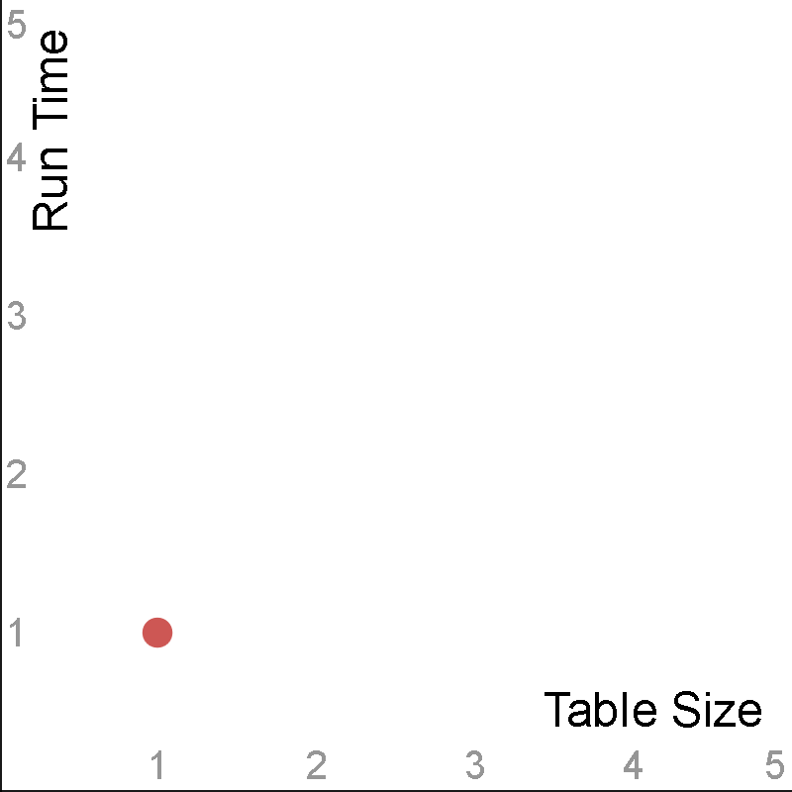
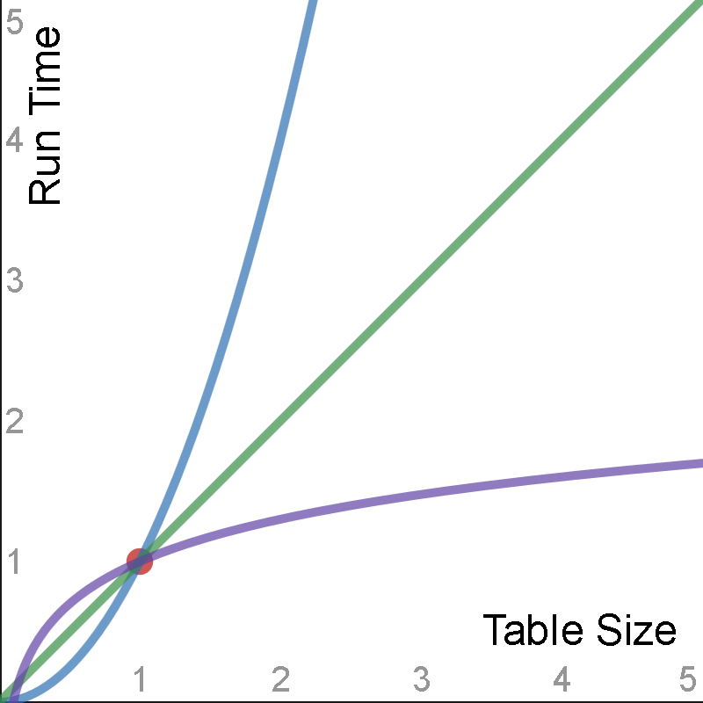
The Stakes are High
Orders of magnitude differences
"a million times faster" is only the beginning
Think about slopes, not points
Notes:
Programming is one of the few fields with orders of magnitude difference in skill level between professionals. We’ve all had to deal with coworkers who are only one tenth as productive as us, and we’ve all been humbled by developers whose code is ten times better than ours. With performance tuning those numbers get even higher, and the rewards are greater. It’s exhilarating when we make a small tweak and something runs a million times faster.
We like to talk about things being "X times faster or slower", but that's only the story at a single point-in-time.
We need to think about the slope instead of a single point. We want to know how is our application going to grow with the data size.

Slide 7
Run-time Analysis Theory
Simple math
Focus on run-time*, not space
Big O notation - function that describes the worst case
Replace ratios with functions
A few functions describe every database feature
Useful for both proactive and reactive tuning
Focus on practical, not theoretical
Ignore a LOT of implementation details and constants
Notes:
Although algorithm analysis is usually taught in college it only requires high school math. And most of the hard work has already been done for us. For example, it's already been proven that sorting cannot be done faster than O(N*LOG(N)), we don't need to re-prove it here.
Most of this presentation is about time. Although space can be important, and will occasionally be discussed. There is an asterisk by run-time because we're not actually measuring the literal wall-clock time. Algorithm analysis depends on generic "steps", not seconds, minutes, or hours.
There are many different ways to describe these functions. For simplicity we will only use the Big O worst-case complexity.
Instead of saying "A is X times slower than B at point Y", we can say "A is O(N^2) and B is O(N)."
This presentation is going to ignore a ginormous amount of implementation details and constants. Those details definitely matter, and can sometimes override algorithm complexity, but in many cases we can ignore them.
A surprisingly small number of functions can describe every possible database operation, as we'll see later.
Algorithm analysis helps with proactive tuning because we need to know the advantages of different data structures - for example, why should we build indexes? Algorithm analysis is helpful for reactive tuning because we need to compare the algorithms and data structures that Oracle chose, and try to determine why it made a bad choice.
There are an infinite number of functions, this presentation only focuses on a small number of functions that are relevant for Oracle database operations.

Slide 8
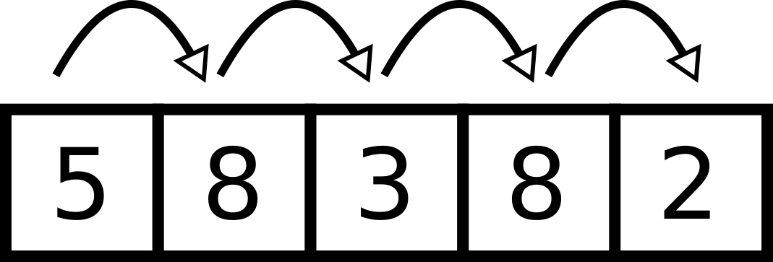
Run-time Analysis Example (1)
Linear search of array or heap table
--Find positions for "8".
declare
v_array sys.odcinumberlist := sys.odcinumberlist(5,8,3,2,8);
begin
for i in 1 .. v_array.count loop
if v_array(i) = 8 then
dbms_output.put_line(i);
end if;
end loop;
end;
/
Notes:
The simplest way to start with algorithm analysis is with a simple linear search algorithm. A FOR loop that goes from 1 to N uses N operations.

Slide 9
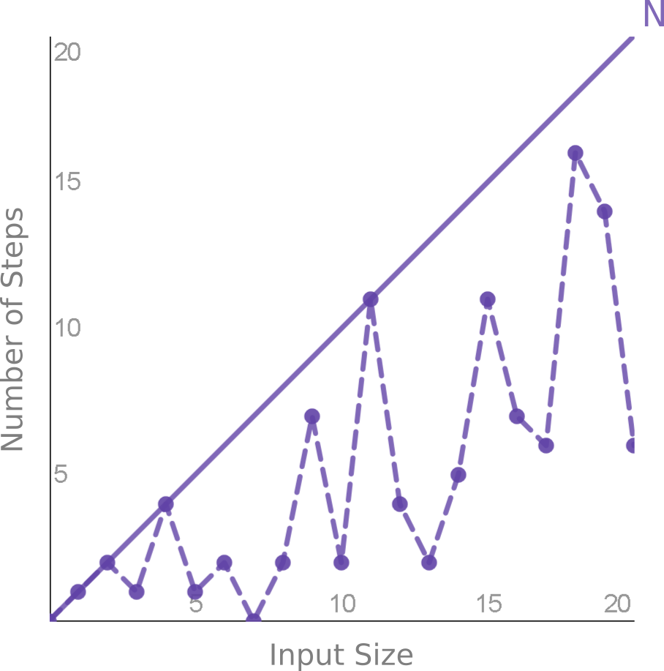
Run-time Analysis Example (2)
Best case is O(1)
Average case is O(N/2)
Worst case is O(N)*
Many lectures available online
Notes:
O(1) - If we're lucky we'll find the element immediately, and only need 1 lookup.
O(N/2) - On average we'll have to search half of the elements, N/2.
O(N) - If we're unlucky we have to search each of the N elements. Worst case is the most realistic. Unless we have a unique array or index, we have to continue searching through all N elements, even if we find a match. For example, in the previous slide there were duplicate values, one near the beginning, and one near the end.
This is not a full introduction to algorithm analysis. If you're interested in this topic I recommend you search for "algorithm analysis" and read one or two of the computer science lectures. The topic usually does not require a heavy math background.

Slide 10
A New Performance Story
Ignore database tuning, SQL tuning, advisors, reports, tools
Popular functions guide us through performance categories
Start with fastest and end with slowest
Notes:
Oracle performance tuning is a huge topic and there are many ways to teach it. Even listing and ordering the topics is a huge effort. Let's ignore the common tuning techniques and do something totally different.
We only need a small number of popular functions to describe almost every Oracle feature.
There are many ways to discuss performance topics, I've arbitrarily chosen to list the functions from fastest to slowest.

Slide 11
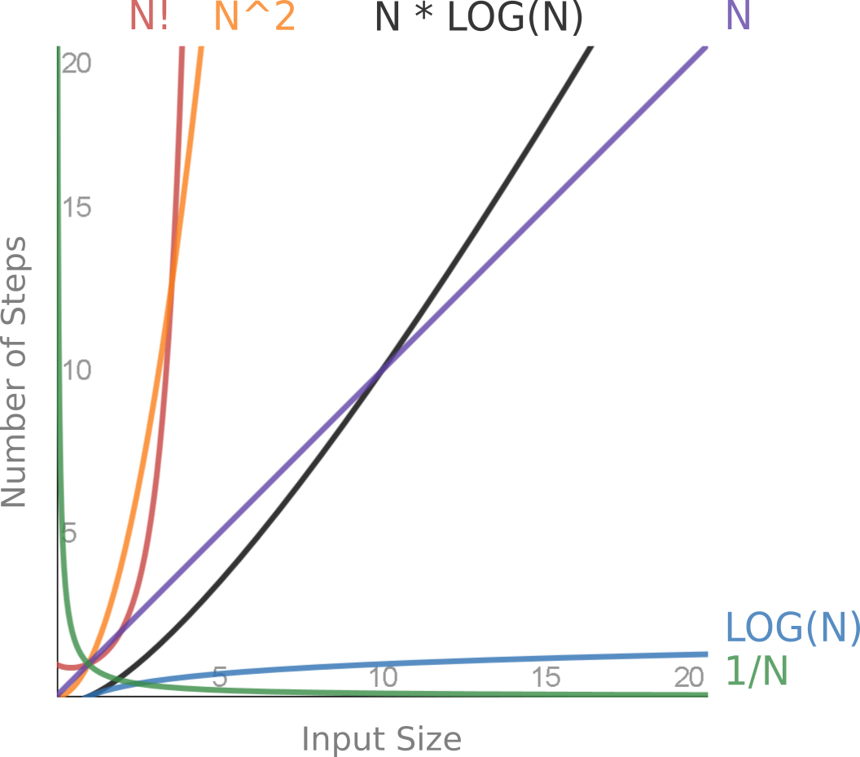
Popular Functions
Notes:
This graph shows the common functions described later in this presentation.
In addition, the presentation also covers O(1), O(∞), and Amdahl's Law. Those functions are either trivial or too hard to display.

Slide 12
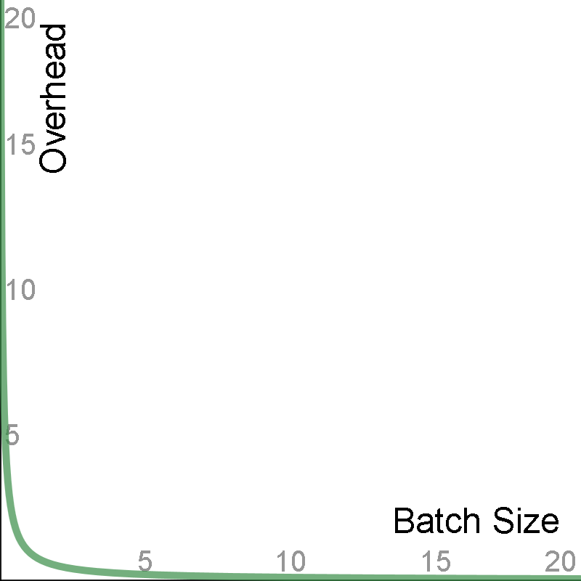
1/N
Notes:
Weird, contentious, fast: The first function is perhaps the weirdest, and most contentious topic, but also one of the most useful.
Different Axes: Almost all of the functions plot time versus input size, but this one is a bit different. In practice, sometimes Overhead versus Batch Size is more important than Run Time versus Input Size.
Boring: This graph may look boring, but boring is good. We want things that quickly go to zero.
Fast, left vs. right: Notice how quickly the line approaches 0 on the y-axis. If we find ourselves in one of these situations we must try very hard to not be on the left-hand side, but we don't have to go very far on the right-hand side.

Slide 13
1/N - What and Where
Harmonic progression
Context switching for every N items
(Overhead analysis, not run-time analysis)
(N * REAL_WORK) + ((N * OVERHEAD_TIME) / BATCH_SIZE)
Any process with a tunable batch or cache size
Sequences, bulk collect limit, prefretch, arraysize, UNION ALL, DBMS_OUTPUT, DBMS_SCHEDULER, etc.
Notes:
1/N is called the harmonic progression. (The harmonic series is much more common, but we're not doing a series here, just one batch size at-a-time.)
Context switching is a performance killer for so many applications. It's a huge topic that applies to much more than just database development. Anytime we can process in bulk, or build an assembly line, there are so many optimizations available.
This is not technically a "run-time analysis", this is more like an "overhead-analysis". But there is a strong relationship between the two, since many operations are completely dominated by overheard instead of the real work.
For the total amount of work we need to measure two things - the "real work" and the overhead. Every operation always has some actual work that is inevitable. For example, with an INSERT, obviously we have to spend time inserting the row. By overhead, I refer to things not directly related to the operation, like the time to generate a sequence needed for that INSERT.
There are so many operations that this applies to.

Slide 14
1/N - Why it Matters
Don't waste time trying to perfect this
Why does increasing batch size help?
BATCH_SIZE 2 = 50% optimized
BATCH_SIZE 10 = 90% optimized
BATCH_SIZE 100 = 99% optimized
Why ever go over 100? Trade space for (no) time
Most tests are wrong
Notes:
You don't need to test this every time. You can never get the perfect batch size, but luckily we can easily get one that's good-enough.
Think about why increasing the batch size helps. It helps by eliminating overhead. But there's only so much overhead to eliminate. There's always going to be the real work, which the batch size won't help with.
Going over 100 is almost certainly a mistake. Compare to no batching at all, you cannot theoretically improve the performance by more than 1%.
But then why do some test cases demonstrate further improvements? Only if they include absolutely no real work. (I've built guilty of this myself.)

Slide 15
Large Batch Sizes Shouldn't Help
If huge batches sizes help we're doing something wrong.
declare
v_count number;
begin
for rows in (select * from large_table) loop
v_count := v_count + 1;
end loop;
end;
/
Instead use: select count(*) from large_table
Notes:
If we find ourselves in a position where increasingly large batch sizes make a significant difference, then we're doing something wrong.
If we care too much about context switching, then maybe we're not using enough SQL.

Slide 16
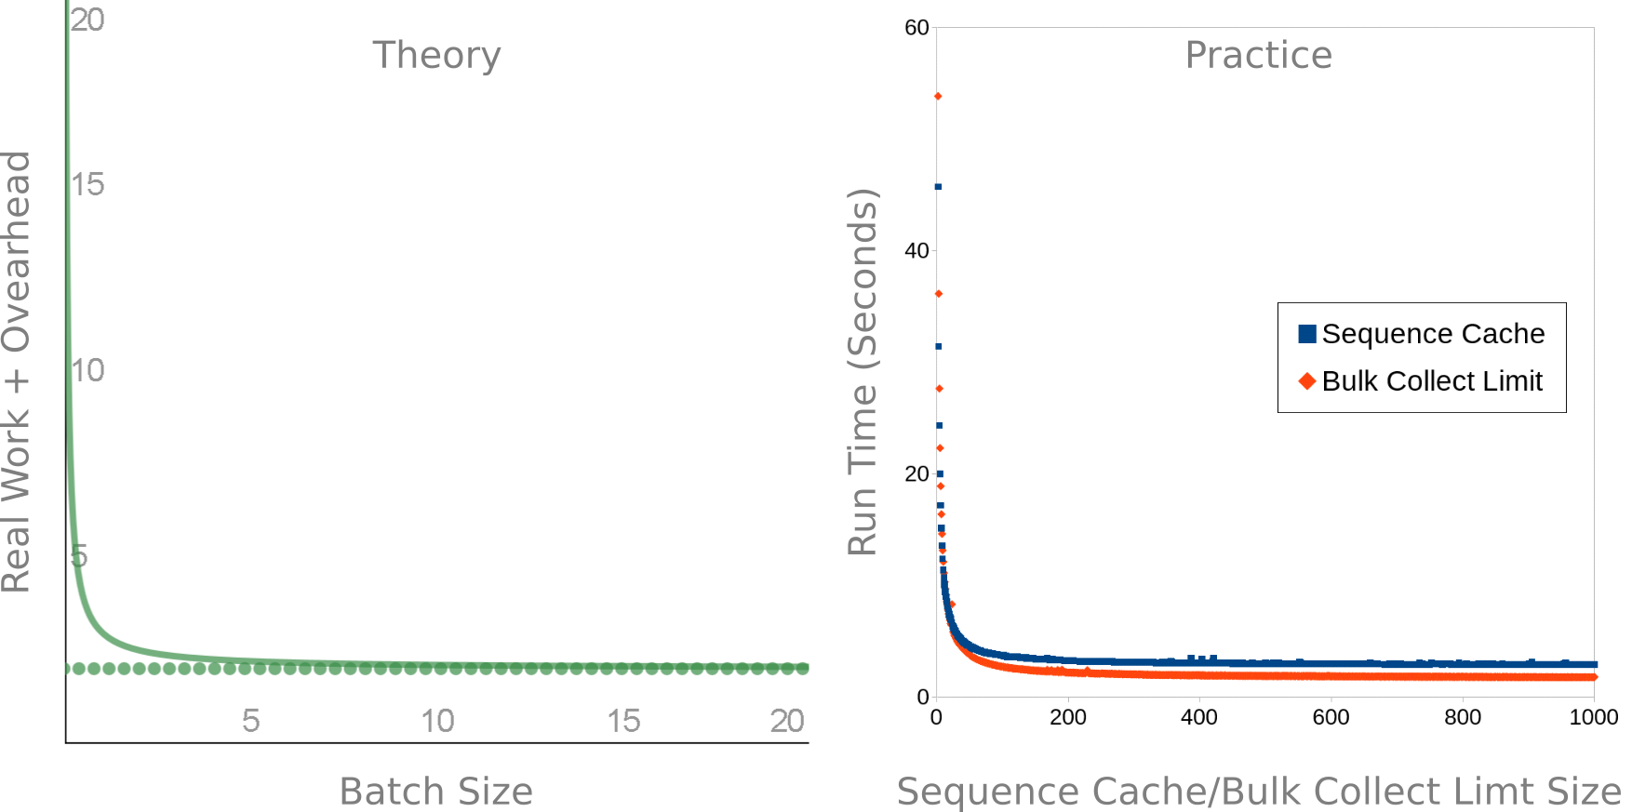
1/N - Theory vs. Practice
Notes:
Match: I built two test cases for sequence cache size and bulk collect limit. Notice how the theory and practice almost perfectly line up.
Plot it: It's important to build a test case with a huge number of points to avoid biases. If I randomly picked some different limit sizes, and re-ran a few times, I could prove anything I wanted to. But when the numbers are plotted out it becomes obvious what the trend is.
Asymptote: Notice the asymptotes at the bottom of the

Slide 17
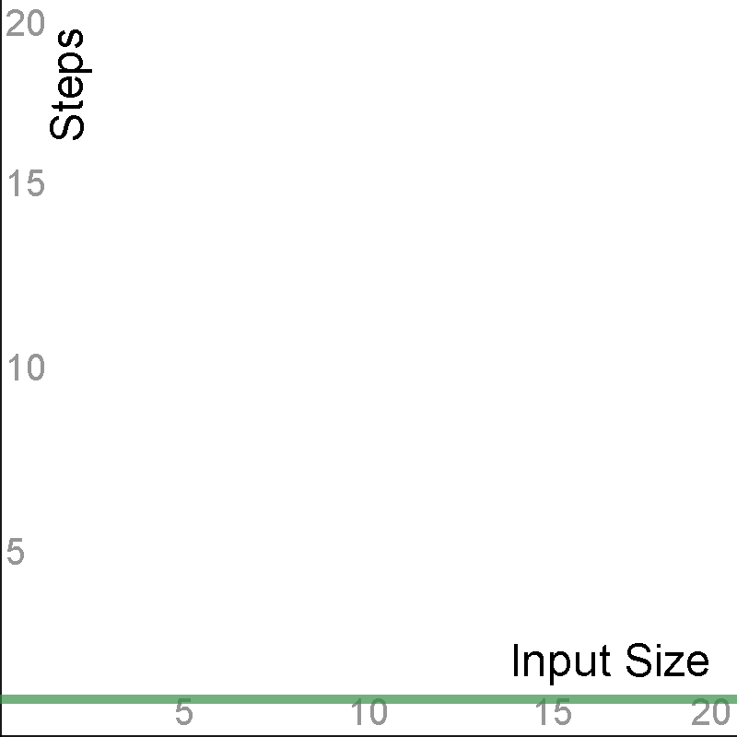
1
Notes:
This boring function was not even show in the comparison graph earlier.

Slide 18
1 - What and Where
Constant time - boring is good
INSERT VALUES*, CREATE, DROP, TRUNCATE, ALTER SESSION, etc.
Hashing (one value) - partitioning, hash clusters, joins
Notes:
Constant time means the run time does not depend on the size of the data - which is a great thing when it's possible.
This happens with lots of operations, mostly with DDL. It might happen with INSERT VALUES, unless the table has indexes that require extra work, or if the table is a cluster.
O(1) *could* happen for hashing in theory, but in practice it won't occur. This affects partitioning, hash clusters, and joins.

Slide 19
1 - Hashing
Map a value to a set of buckets
Useful for grouping, comparing, cryptography, etc.
select ora_hash('A', 100) from dual;
80
select standard_hash('A', 'SHA256') from dual;
559AEAD08264D5795D3909718CDD05ABD49572E84FE55590EEF31A88A08FDFFD
Notes:
Hashing is conceptually simple and generic - we take an input and we map it to an output.
Hashing is a core database operation and is used frequently. It's great for grouping data (like for GROUP BY, DISTINCT, hash partitioning), comparing (for joining, hash clusters), and hiding data (password hashes, de-identifying).
Oracle has several built-in hash functions, such as ORA_HASH, STANDARD_HASH, DBMS_CRYPTO, DBMS_SQLHASH, and probably others.

Slide 24
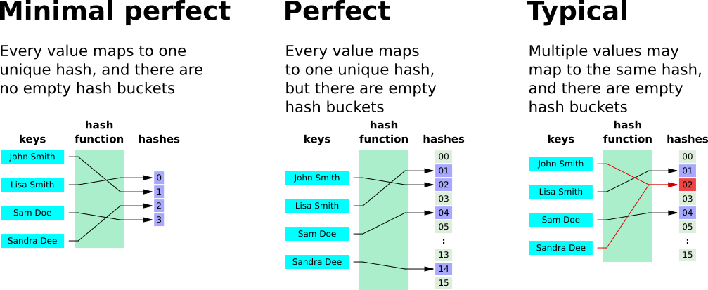
1 - Hashing Types and Tradeoffs
Notes:
There are many hash properties and there's not enough time to go over all of them. Three of the most popular types of hashes are displayed here.
The minimal perfect hash is an unrealistic goal. In practice you will never achieve a hash that good, unless you know all of the values ahead of time and spend a huge amount of processing time.
In practice, we have to choose between a
(Images by Jorge Stolfi - Own work, Public Domain, https://commons.wikimedia.org/w/index.php?curid=6601264)

Slide 25
Minimal perfect
Minimal vs perfect - trade-offs
typical

Slide 26
1 - Hash Partitioning
Minimal: Probably, Perfect: No
Trades time for space
ORA_HASH
Good for retrieving large percentage of rows
Insert O(1), read is O(N/#_PARTITIONS)
Don't use huge number of partitions

Slide 27
1 - Hash Clusters
Minimal: No, Perfect: Maybe
Trades space for time
Unknown hash function
Good for retrieving small percentage of rows
O(1) reads, theoretically better than indexes
In practice it's slower (constants win)
Creating perfect hash increases table size 3x
Notes:
See this Stack Overflow answer, where I try and fail to create a useful constant-time index using hash clusters: https://stackoverflow.com/questions/32071259/constant-time-index-for-string-column-on-oracle-database

Slide 28
1 - Hash Joins
Minimal: No, Perfect: No
Somewhere between O(1) and O(N)
In practice, best way to join large tables

Slide 29
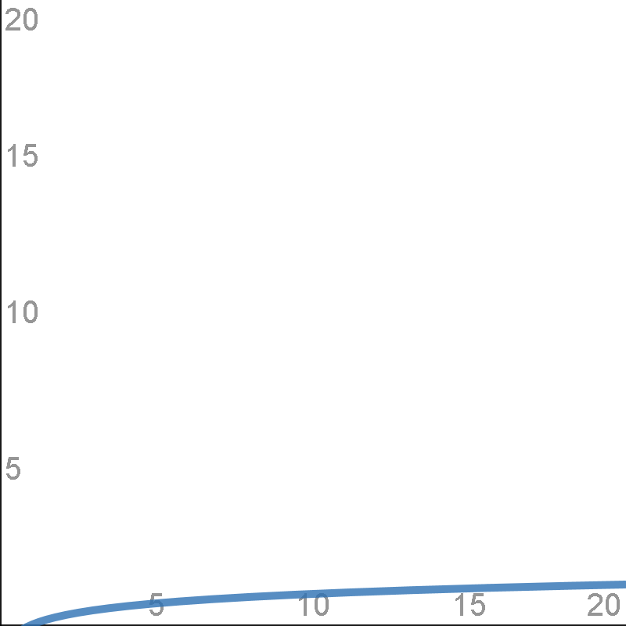
LOG(N)

Slide 30
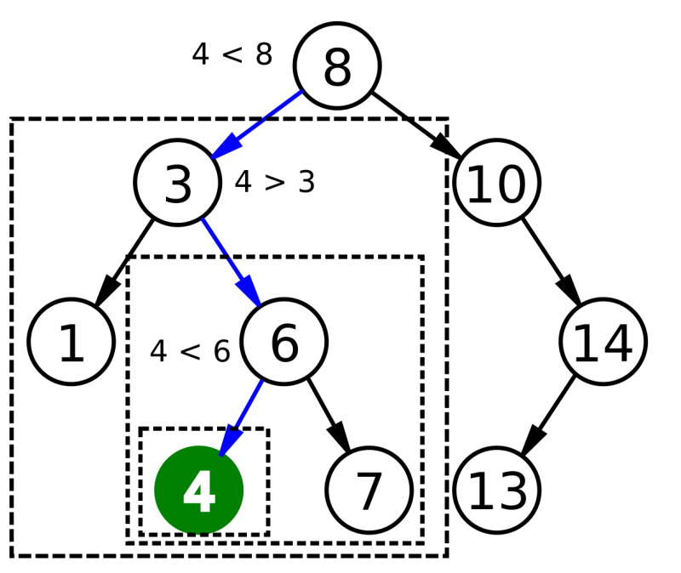
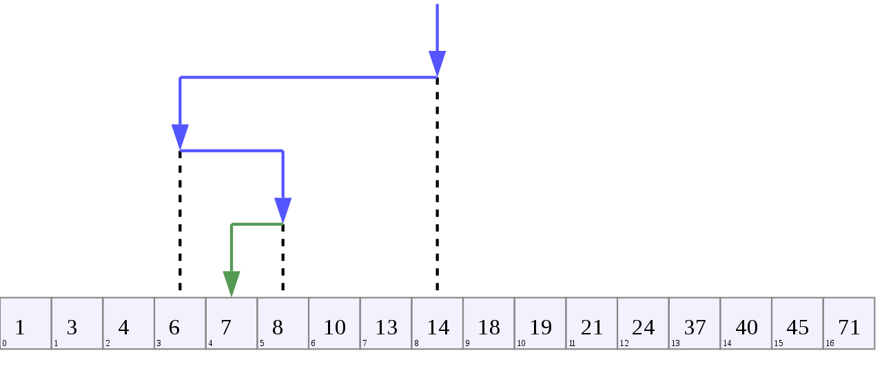
LOG(N) - B-Tree Visualizations
Notes:
Binary search algorithm image created by Chris Martin and is in the public domain.
Binary Search Depiction by AlwaysAngry is licensed under the Creative Commons Attribution-Share Alike 4.0 International license.

Slide 31
LOG(N) - What and Where
Binary math - each bit doubles
Binary search - each decision halves
Exponent and logarithm are opposites
Binary number 2^N, binary search LOG2(N)
Real indexes aren't binary, use LOG not LOG2

Slide 32
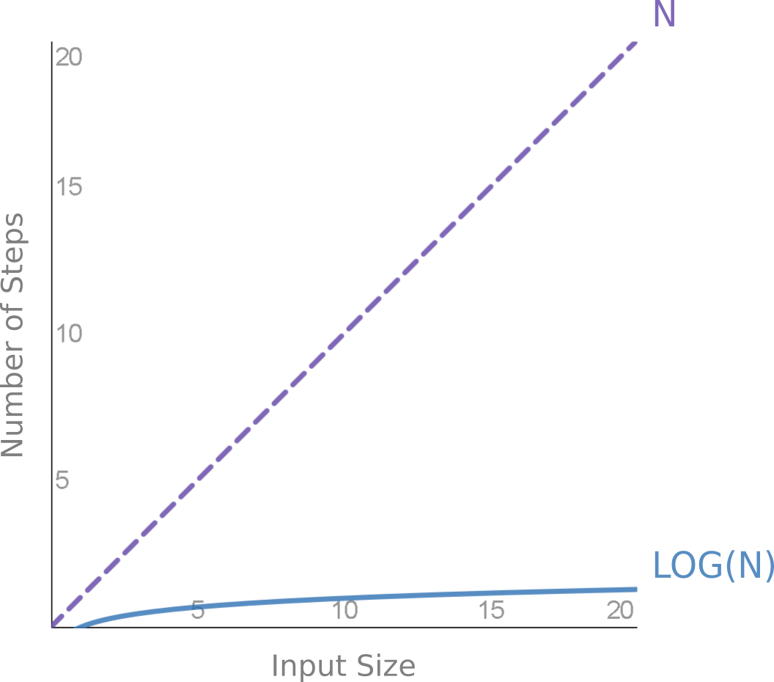
LOG(N) - Fastest for Small Access
Notes:
We're still only talking about accessing a single value.

Slide 33
LOG(N) - Why it Matters
This is why indexes are so fast
Data doubles, index access may stay the same
One search is LOG(N), N searches is N*LOG(N) and is discussed later

Slide 34
LOG(N) - Height of 3 Million Indexes
BLEVEL | Count
 | 899,972
0 | 2,097,419
1 | 245,841
2 | 42,303
3 | 2,601
4 | 54
5 | 24
6 | 25
7 | 3
9 | 1
11 | 1
Notes:
Index height does not grow fast in practice.
Generated by this query (run against the 350 databases I have access to)
select blevel, count(*) count
from dba_indexes
group by blevel
order by blevel nulls first;

Slide 35
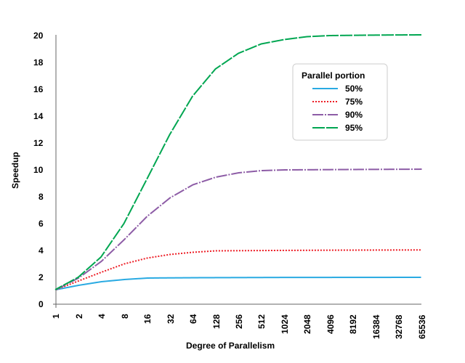
Amdahl's Law - 1/((1-P)+P/N)
Notes:
Amdahl’s law as a graph. Based on “Amdahl’s Law” by Daniels220, licensed under CC BY-SA.

Slide 36
Amdahl's Law - Depressing Results
Must parallelize EVERYTHING
Diminishing hardware returns: 128 cores at 95% = 17.4x 256 cores at 95% = 18.6x
Focus on parallelizing 128 cores at 96% = 21x

Slide 37
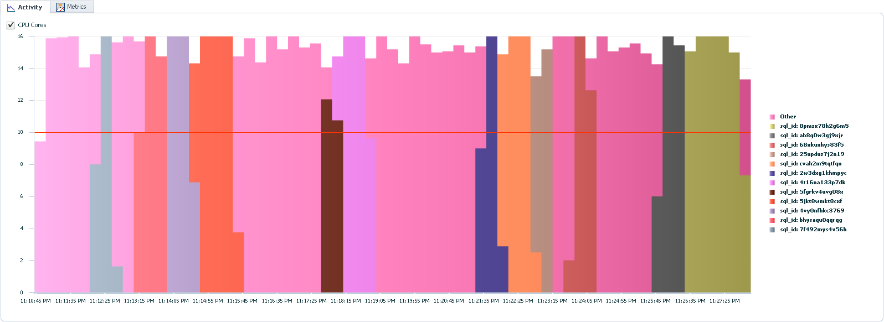
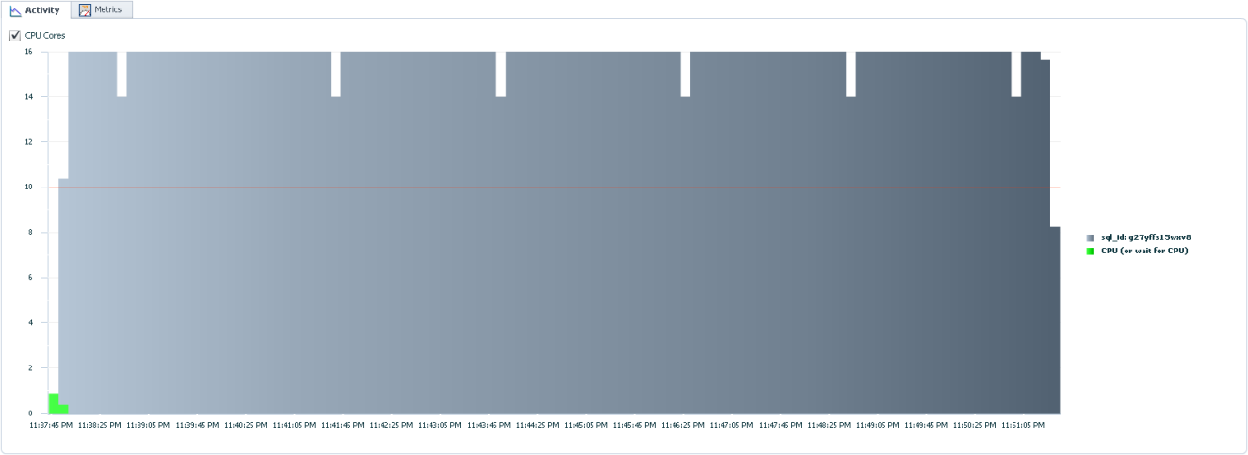
Amdahl's Law - Measure Carefully
Notes:
These pictures compare different ways to read a table in parallel. The top, colorful chart shows reading one-partition-at-a-time. The bottom, boring chart shows reading a table with a single SQL statement.
In this case, boring is good. The boring chart has very few edges, which means it's getting the most parallelism possible. If we want to improve performance by X we need to have X threads running at every possible moment.
We must have tools to measure and visualize utilization or we'd never know what's missing.

Slide 38
Amdahl's Law - Parallelize Everything
Don't only parallelize INSERT or SELECT
Index rebuilding
Gathering statistics
Constraint validation

Slide 39
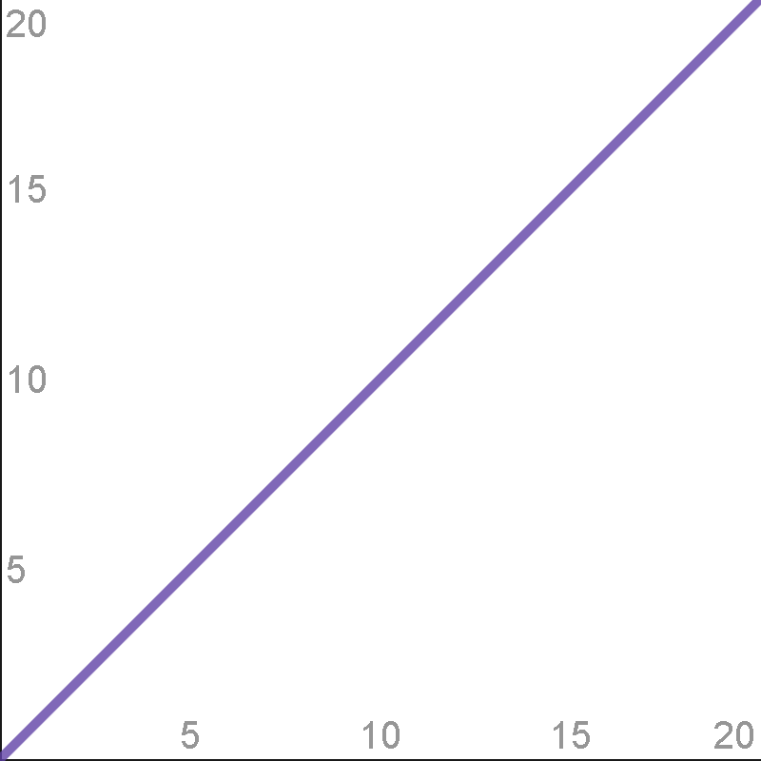
N

Slide 40
N - Linear Growth
Full table scan, fast full scan, parsing, basic compression, DML, etc.
In practice, most common function
Most effort is spent here
2x improvement is nice
Now it's time to compare functions
Notes:
Changes like using direct-path writes are "only" a 3x improvement, but that's still pretty awesome.

Slide 41
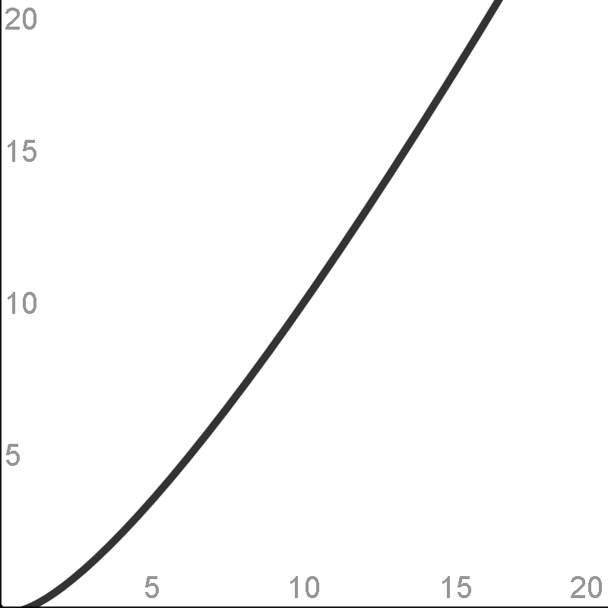
N * LOG(N)

Slide 42
N * LOG(N) - What and Where
Sorting
Iterated index access
Local index (partitioned indexes)

Slide 43
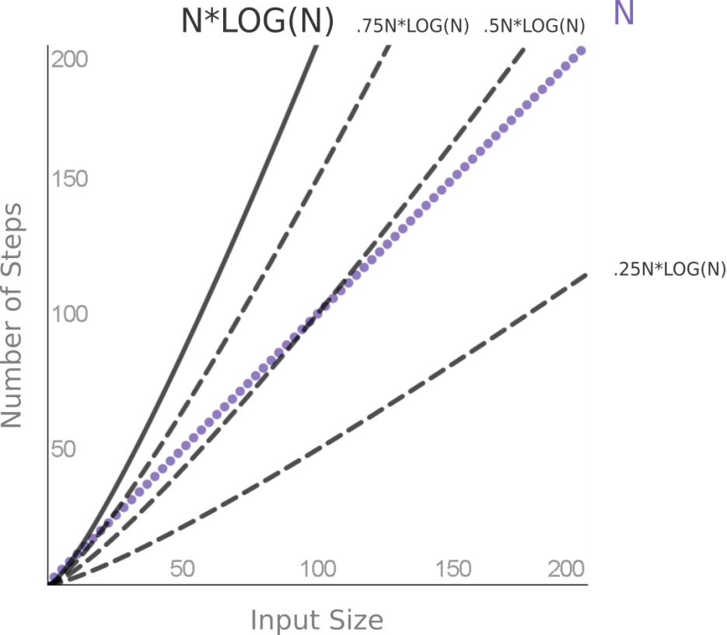
N * LOG(N) - Full Table Scan vs. Index
Notes:
Difficult choice: It's not obvious when a full table scan is cheaper than an index read. It depends on the percentage of the index and how big the data is.
Other factors: Clustering factor, multi-block versus single-block read time affect the choice.
Theory versus practice: Theory tells us the *shape*, but practice tells us the actual number where they diverge.
Cardinality: This is why cardinality is important. Oracle must know where on the X-axis we are, to know which choice is better.

Slide 44
N * LOG(N) - Sorting
ORDER BY time does not grow linearly
Space grows linearly
Index full scan - do sorting ahead of time

Slide 45
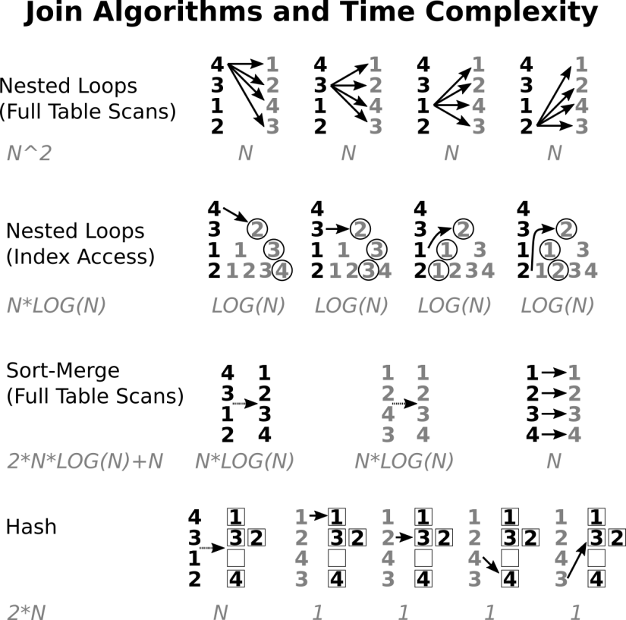
N * LOG(N) - Joining

Slide 46
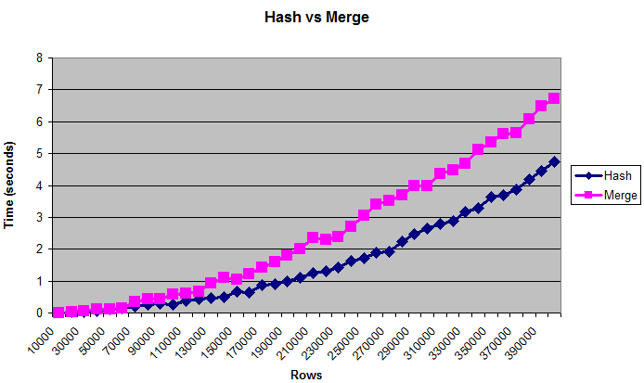
N * LOG(N) - Hash vs. Merge
Hash is worse than O(2N), but better than O(N*LOG(N))
Notes:
Chart is from my answer here: https://stackoverflow.com/questions/8188093/oracle-always-uses-hash-join-even-when-both-tables-are-huge

Slide 47
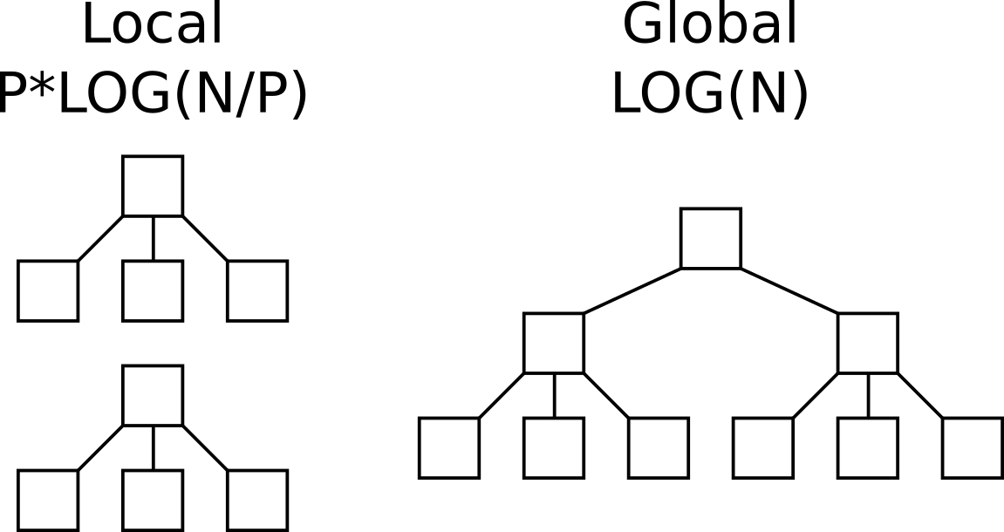
N * LOG(N) - Local vs Global Indexes

Slide 48
N * LOG(N) - Gathering Statistics
Counting distinct is like sorting - O(N*LOG(N))
Approximate NDV is O(N) instead of O(N*LOG(N))
Cardinality vital, but estimate good enough
Always use default for ESTIMATE_PERCENT

Slide 49
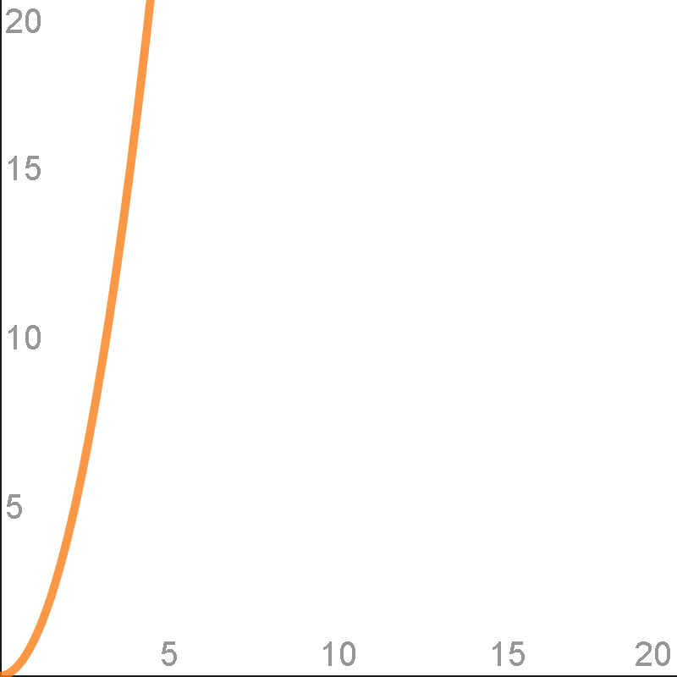
N^2

Slide 50
N^2 - What and Where
Nested loops ------------------------------------ | Id | Operation | Name | ------------------------------------ | 0 | SELECT STATEMENT | | | 1 | NESTED LOOPS | | | 2 | TABLE ACCESS FULL| TEST1 | | 3 | TABLE ACCESS FULL| TEST2 | ------------------------------------
Pseudo-code: FOR i IN 1 .. TEST1.COUNT LOOP FOR j in 1 .. TEST2.COUNT LOOP ("i" and "j" are both inputs, let's call them "n")
MODEL, parse time for 500+ UNION ALL

Slide 51
N^2 - Why it Matters
N^2 is horrible, avoid at all costs
Except near 0 where constants dominate (cross joins are not always evil)

Slide 52
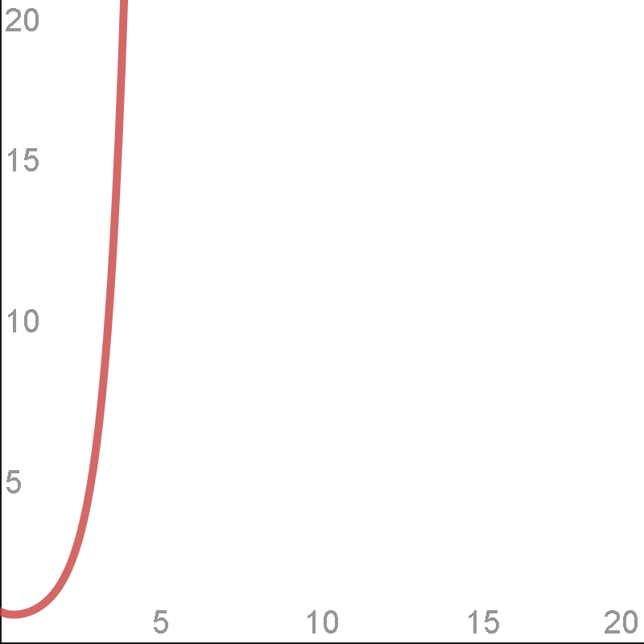
N!

Slide 53
N! - What and Where
N factorial. 3! = 3 * 2 * 1
Grows quickly: 5! = 120, 10! = 3,628,800
Occurs when listing all possible orders
Optimizer when finding join order
Our memory when visualizing join order

Slide 54
N! - Why it Matters
2 small sets is less complex than one big set
10! >> 2 * 5!
Pseudo-code: select * from table1, table2, table3, table4, table5, table6, table7, table8, table9, table10 ... versus: select * from ( select * from table1, table2, table3, table4, table5 ... ) view1 join ( select * from table6, table7, table8, table9, table10 ... ) view2 on view1.something = view2.something

Slide 55
∞ - Why it Matters
Halting problem is O(∞)
Optimizer is really a satisficer
Don't expect miracles
Work with the forecast, don't throw it out because of a few bad examples
Gather stats manually and automatically

Slide 56
Summary
Programs = Algorithms + Data Structures
Computer science degree not necessary
A few simple functions explain most behavior
Constants can't always be ignored
Algorithm analysis is foundational to understanding performance

Slide 57
Questions?
jon@jonheller.org
281

